Slide 1

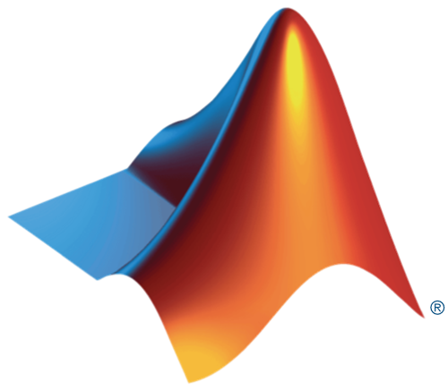

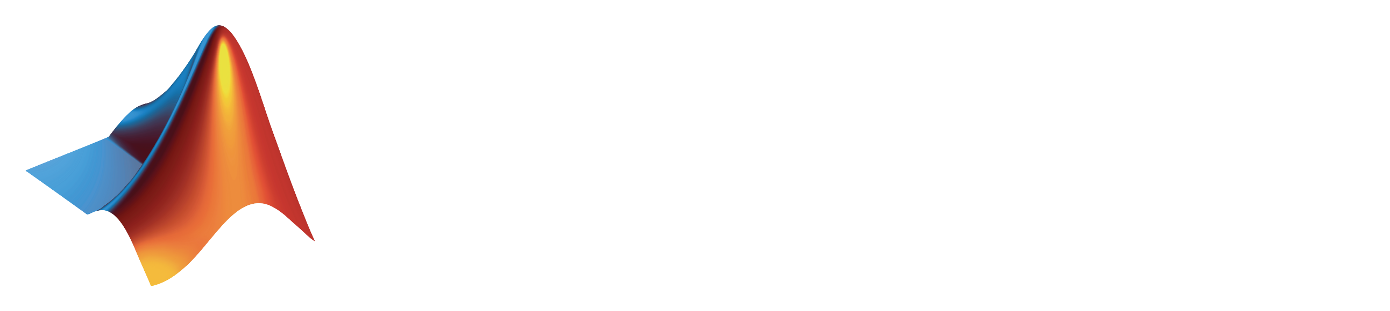
+
MATLAB with Python

Slide 2



+
MATLAB with Python
Laura Keen, Ph.D
Elvira Osuna-Highley, Ph.D
lkeen@mathworks.com
eosunahi@mathworks.com
Notes:
Intro - People
Intro – Technical Contents
We’ll show
How to call Python from MATLAB
How to call MATLAB from Python
How to package our MATLAB program solution – for deployment with Python

Slide 3
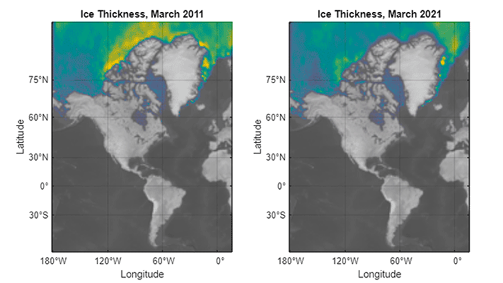
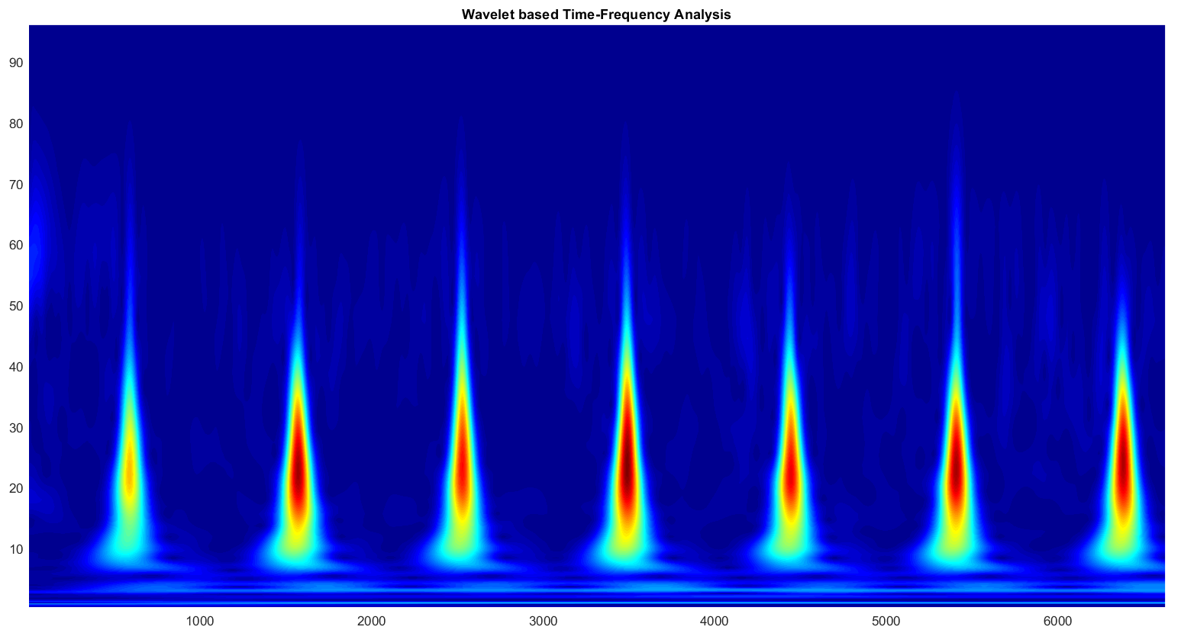
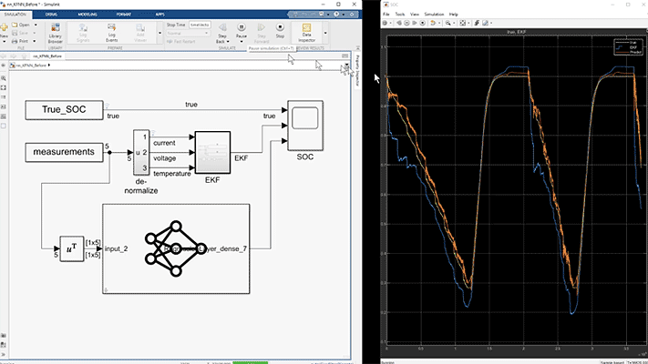
Why use MATLAB and Python together?
Reuse existing code
Use functionality from other language
Collaborate
Notes:
So to sum up
We’ll show
How to call Python from MATLAB
How to call MATLAB from Python
Might want to mention some additional options
How to package our MATLAB program solution – for deployment with Python

Slide 4
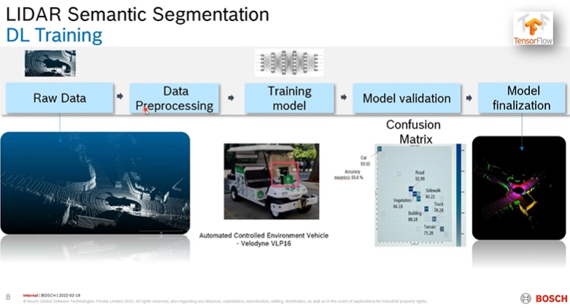
Examples of interoperability in Industry
Bosch Designs and Implements a Lidar Point Cloud Classifier with MATLAB and Deep Learning Toolbox
CODA
Notes:
So to sum up
We’ll show
How to call Python from MATLAB
How to call MATLAB from Python
Might want to mention some additional options
How to package our MATLAB program solution – for deployment with Python

Slide 5
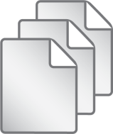
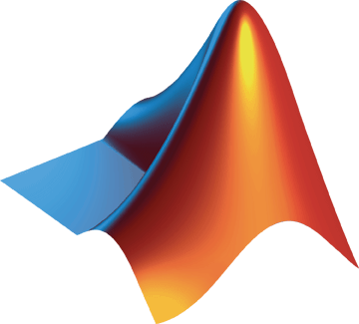
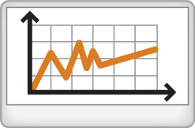
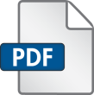
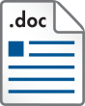

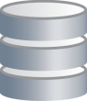
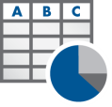


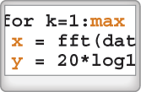


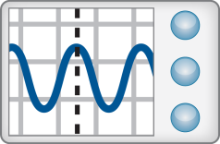
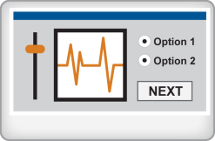
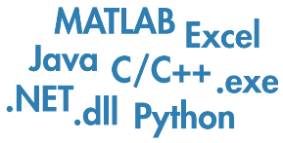
Data Analysis Workflow
Access
Explore & Discover
Share
Files
Reporting and Documentation
Data Analysis & Modeling
Software
Algorithm Development
Outputs for Design
Code & Applications
Application Development
Hardware
Deployment
Automate

Slide 6
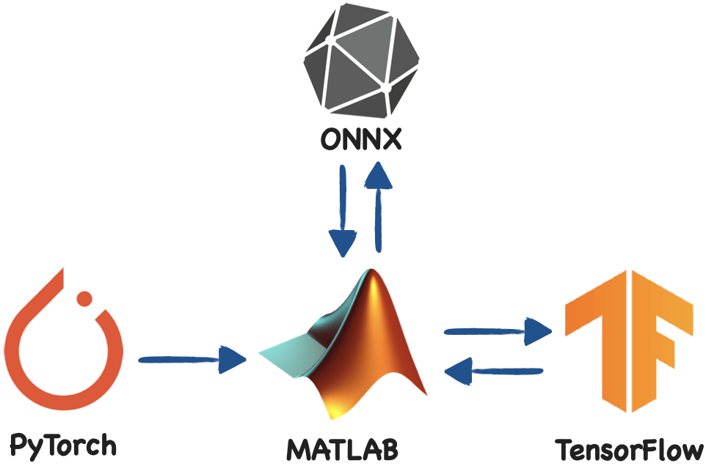
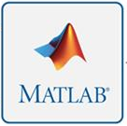
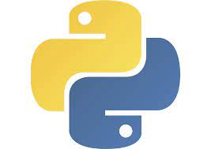
What is interoperability?
Notes:
So to sum up
We’ll show
How to call Python from MATLAB
How to call MATLAB from Python
Might want to mention some additional options
How to package our MATLAB program solution – for deployment with Python

Slide 7




I would like to integrate my colleagues’ Python codes in my MATLAB simulations models, is it possible?
You can call Python code and models directly from MATLAB!
Can I use my colleagues MATLAB codes and apps in Python?
Yes! You can import saved MATLAB models, apps and scripts into Python!
Can I build an engineering project using a Python AI algorithm and deploy it to hardware?
Yes! Import the Python model into MATLAB/Simulink and then deploy it to hardware using automated code generation.
Notes:
So to sum up
We’ll show
How to call Python from MATLAB
How to call MATLAB from Python
Might want to mention some additional options
How to package our MATLAB program solution – for deployment with Python

Slide 8
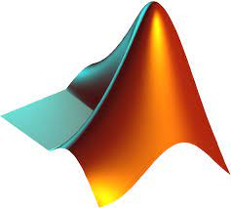
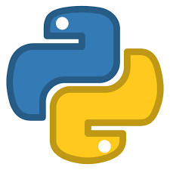
Ways to Interoperate
Python Interface
MATLAB Engine
TensorFlow Converter
ONNX Converter
PyTorch Converter
MATLAB-Python Coexecution
Model Exchange

Slide 9
Ways to Interoperate
Python Interface
MATLAB Engine
TensorFlow Converter
ONNX Converter
PyTorch Converter
MATLAB-Python Coexecution
Model Exchange

Slide 10


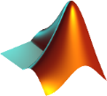
Call Python from MATLAB

Slide 11

Call MATLAB from Python

Slide 12
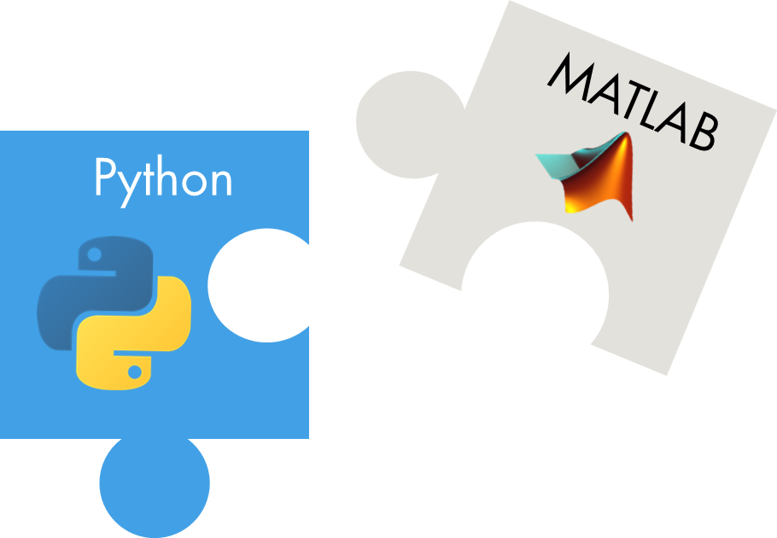
Call MATLAB from Python MATLAB Engine API
Install MATLAB Engine API for Python (from PyPI)
$ pip install matlabengine
Start a MATLAB process
>>> import matlab.engine
>>> m = matlab.engine.start_matlab()
Call MATLAB functions
>>> x = m.sqrt(42.0)

Slide 13
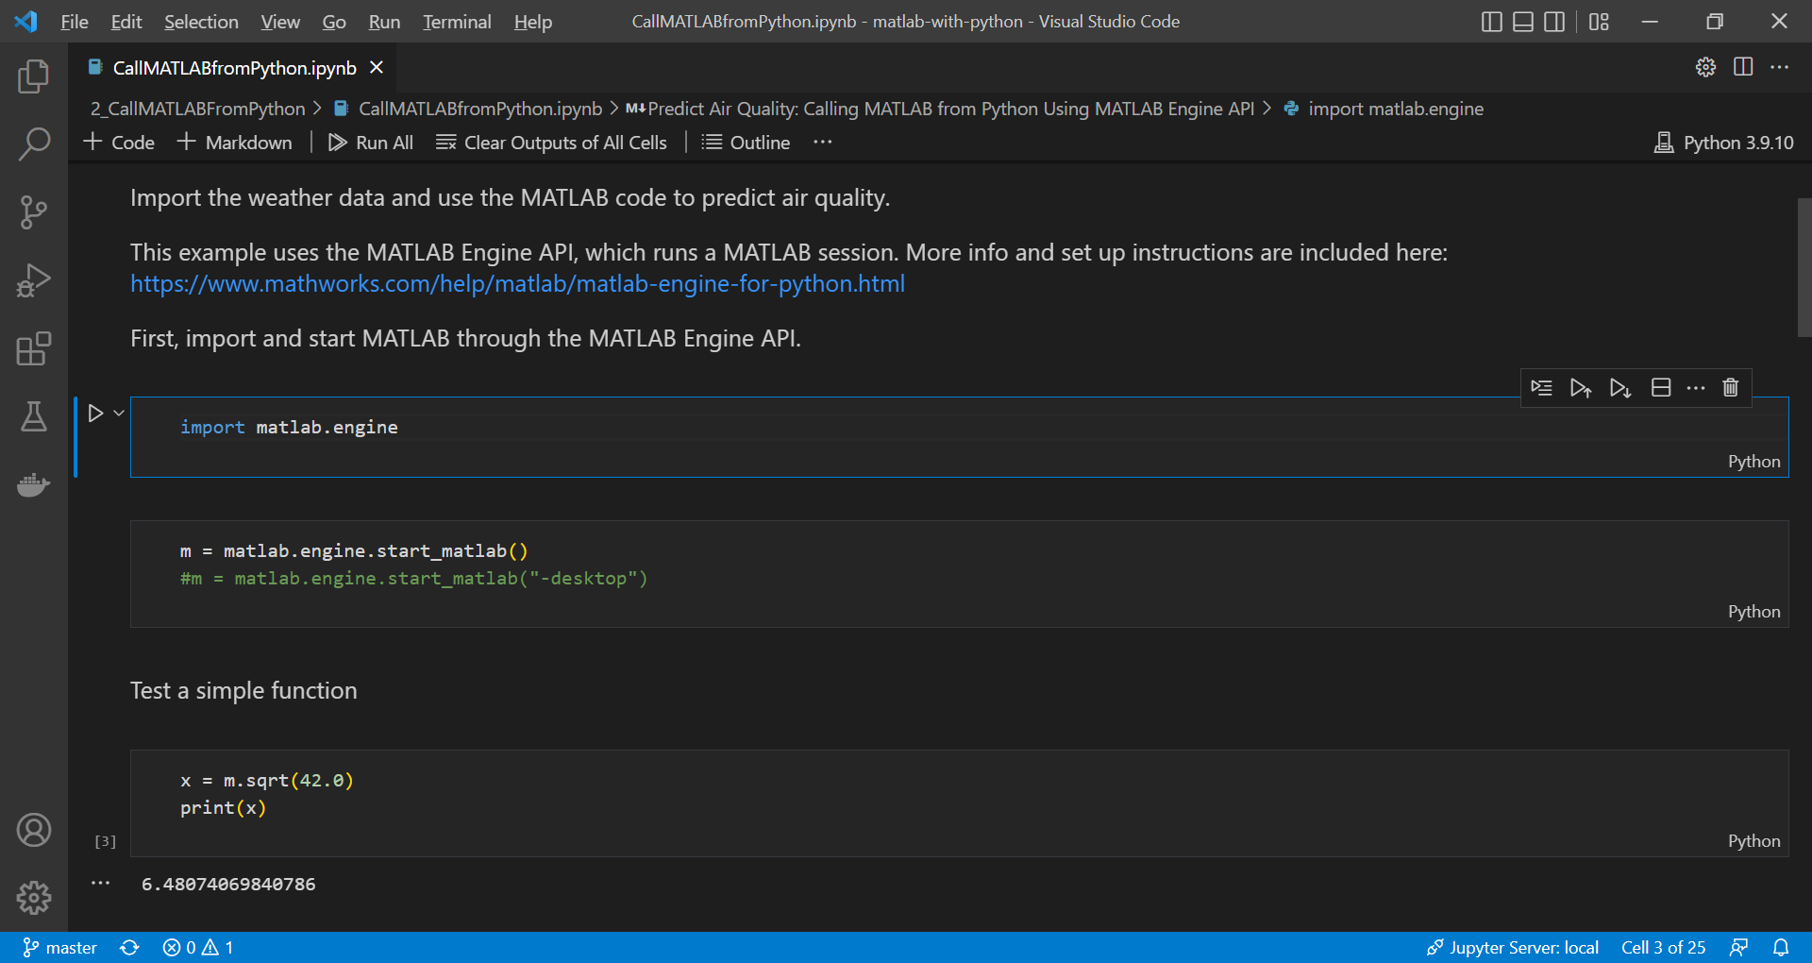

Slide 14


Additional Options
Notes:
I’d like to wrap up this section with some additional options for specific use cases of using MATLAB and Python together.

Slide 15
Ways to Interoperate
Python Interface
MATLAB Engine
TensorFlow Converter
ONNX Converter
PyTorch Converter
MATLAB-Python Coexecution
Model Exchange

Slide 16


MATLAB Central Community
Every month, over 2 million MATLAB & Simulink users visit MATLAB Central to get questions answered, download code and improve programming skills.
MATLAB Answers
Blogs
MATLAB Answers: Q&A forum; most questions answered in < 1 hour
File Exchange: Download code from a huge repository of free code including tens of thousands of open source community files
File Exchange
ThingSpeak
Cody: Sharpen programming skills while having fun
and more…
Blogs: Get the inside view from Engineers who build and support MATLAB & Simulink
Learn
Contribute
Connect
Cody
ThingSpeak: Explore LoT Data
And more for you to explore…

Slide 17





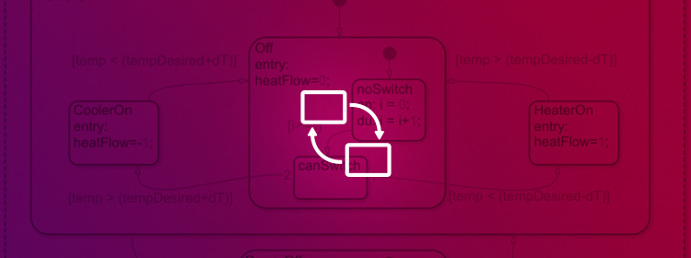

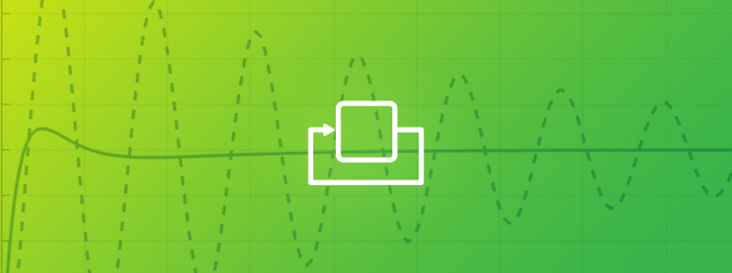
Onramp Courses
Signal
Processing
Deep
Learning
Machine
Learning
MATLAB
Onramp
Image
Processing
Stateflow
Simulink
Onramp
Control
Design
w/Simulink

Slide 18


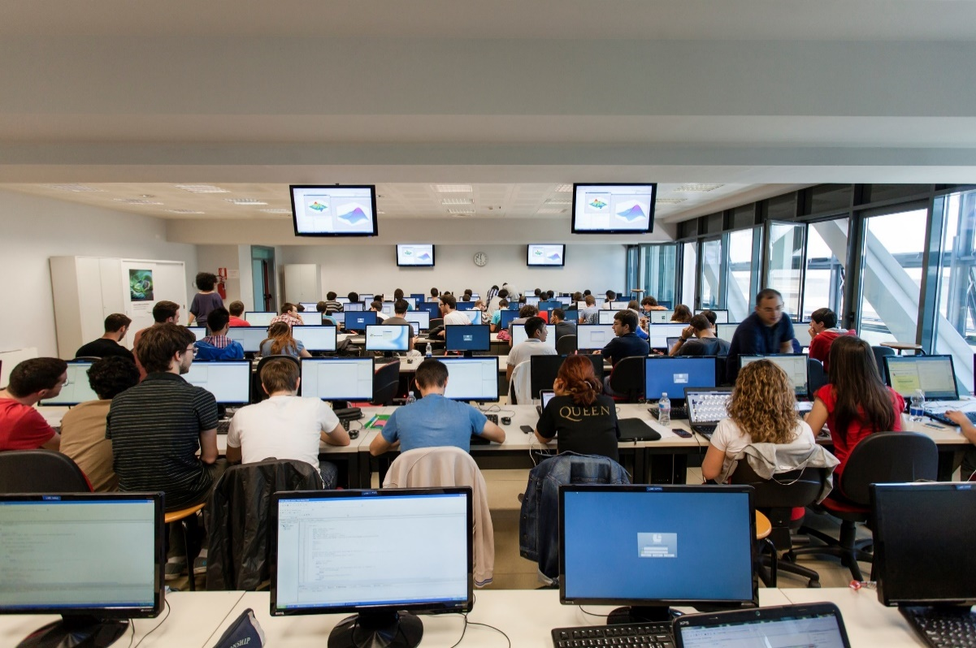


MathWorks Engineering Support
Training
Guided Evaluations
Onsite Workshops
Consulting
Technical Support

Slide 19
Support from MathWorks
Seminar/workshop/training
MATLAB Community Toolbox support
Licenses
Hackathon/event monetary support
MCT Monetary support
DCRG Program
Quick Support
Proposal Required

Slide 20

Contact Info & Thank You!
Laura Keen – Lkeen@mathworks.com
https://github.com/drLKeen/NIHmatlabpython
Elvira Osuna-Highley – eosunahi@mathworks.com
Tim Mathieu – tmathieu@mathworks.com
Matt DiGiandomenico – mdigiand@mathworks.com
+
MATLAB with Python

Slide 21
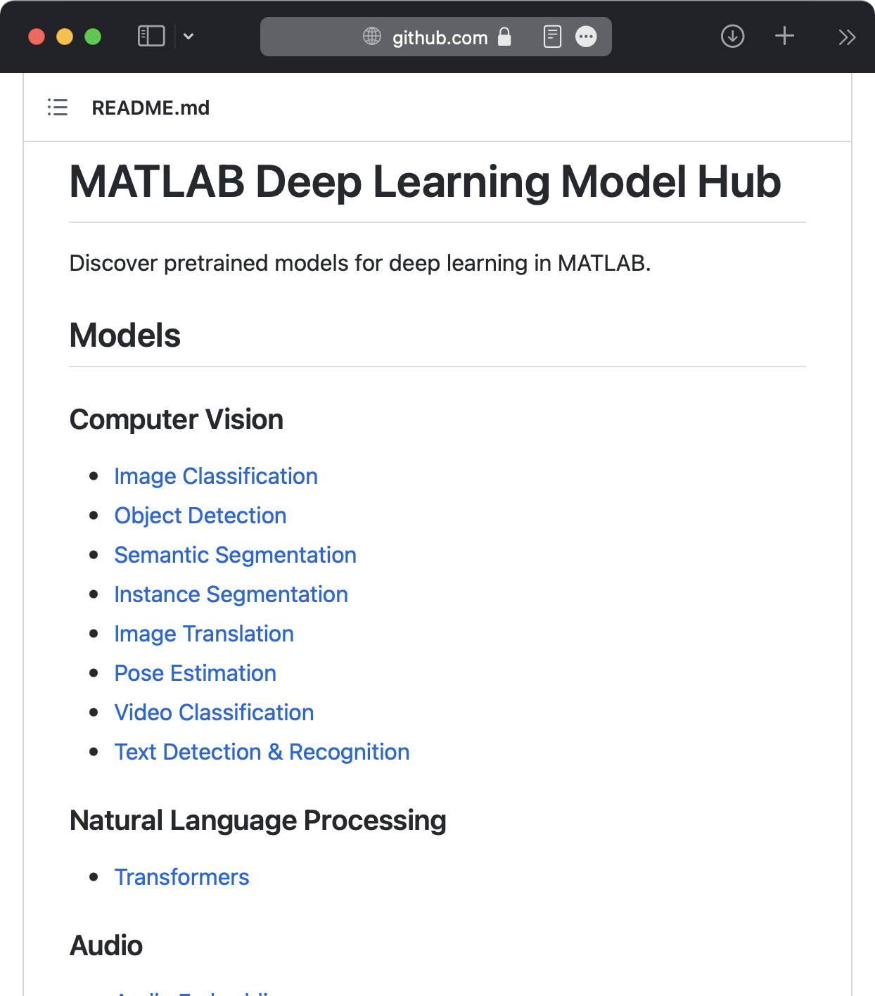
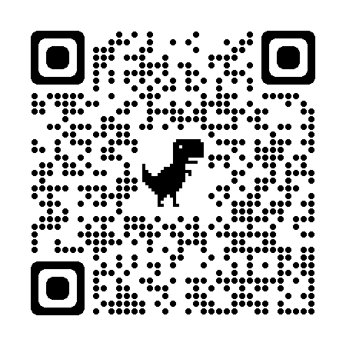
Deep Learning
Co-execution
Model import/export
>> importTensorFlowNetwork("SavedModel")
>> importONNXNetwork("model.onnx")
>> exportONNXNetwork(net,"model.onnx")
https://github.com/matlab-deep-learning/MATLAB-Deep-Learning-Model-Hub
Notes:
One of the most common reasons to use MATLAB and Python together is for deep learning. MATLAB has its own deep learning framework and models, but it is also very popular to use MATLAB with models developed in TensorFlow and MATLAB. For instance, you might use MATLAB apps to label data for training with TensorFlow or PyTorch, and then import those models back for integration into larger MATLAB and Simulink simulations – especially to take advantage of MATLAB Coder and GPU Coder to automatically convert these models into real-time C code for embedded systems and GPUs.
<BUILD – Co-execution>
One approach is to use the co-execution capabilities we’ve shown, to connect MATLAB with Python code that uses TensorFlow or PyTorch.
<BUILD – Model import/export>
You can also import and export models, translating them between the frameworks to run natively within the other environment.
You can directly import TensorFlow models into MATLAB.
<BUILD – PyTorch import>
Currently, PyTorch import is through the ONNX interchange format.
<BUILD – Export>
Similarly, you can export models from MATLAB to TensorFlow and PyTorch via ONNX.
<BUILD – Model Hub>
Finally, we host dozens of pretrained models on the MATLAB deep learning model hub on github. These are already set up and ready to use in MATLAB.

Slide 22
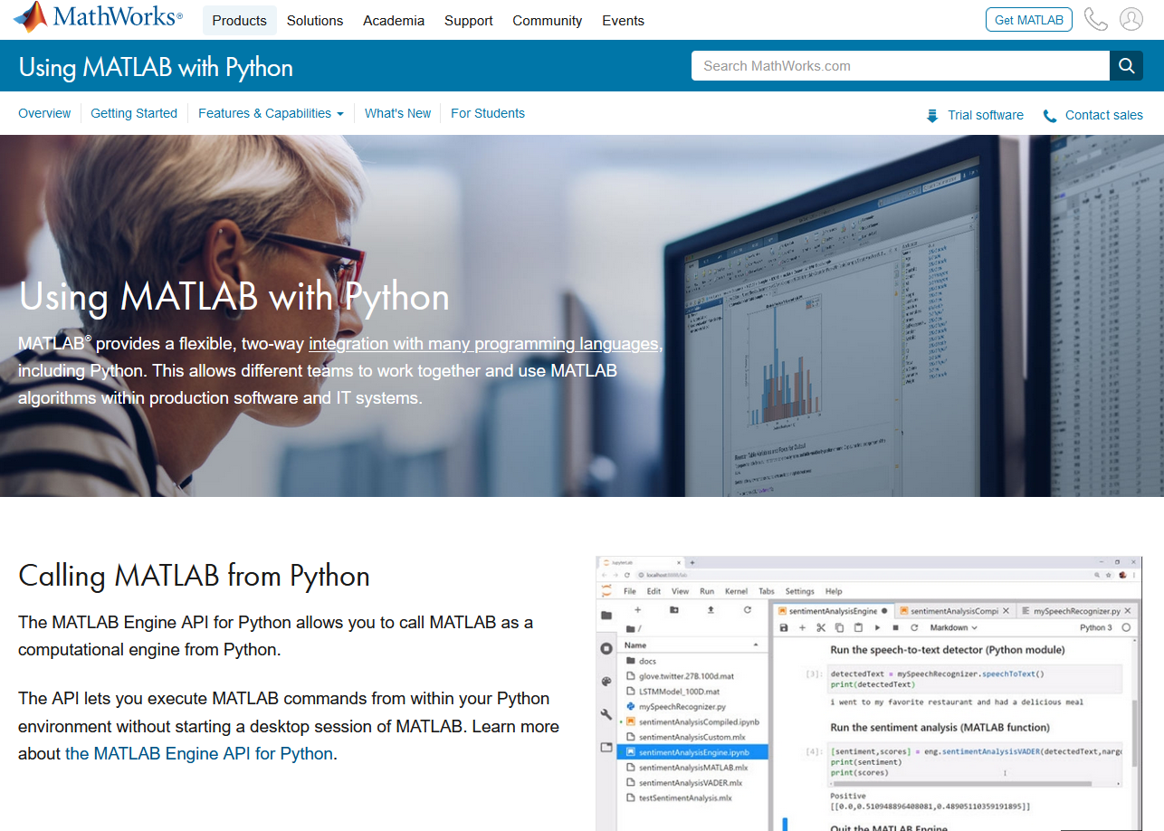
Resources
Cheatsheet
Example on GitHub
Blog post
Videos
Calling Python from MATLAB
Calling MATLAB from Python
Using MATLAB with Python + Q&A (YouTube live stream recording)
Documentation
Calling Python from MATLAB
Calling MATLAB from Python via:
MATLAB Engine API
MATLAB Compiler SDK
MATLAB Production Server
Data management:
Data type conversions
Working with Parquet files
MATLAB library for Apache Arrow
Deep Learning (TensorFlow, PyTorch, etc)
https://www.mathworks.com/products/matlab/matlab-and-python.html

Slide 23
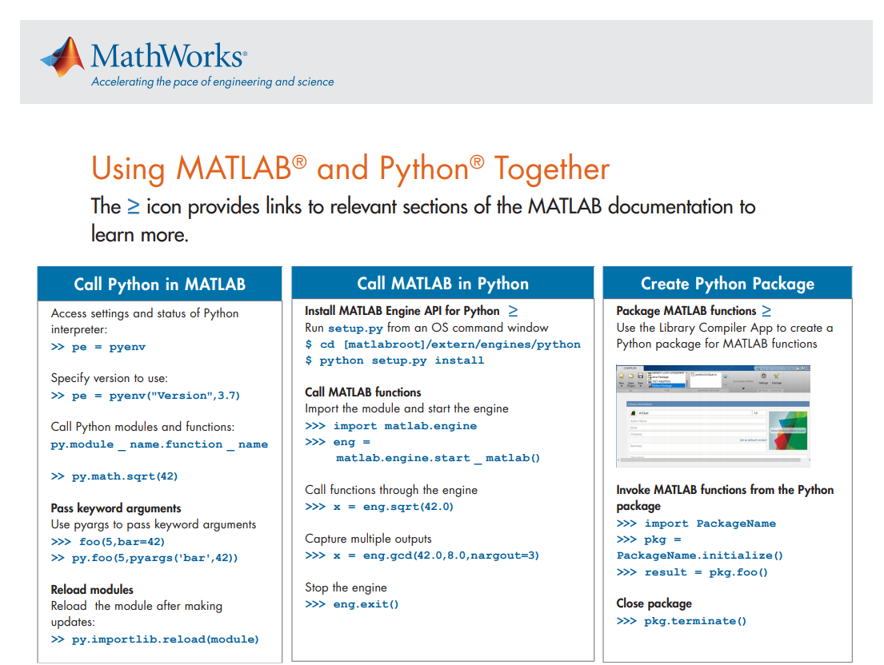
Cheatsheet
Notes:
https://www.mathworks.com/content/dam/mathworks/fact-sheet/using-matlab-with-python-cheat-sheet.pdf

Slide 24
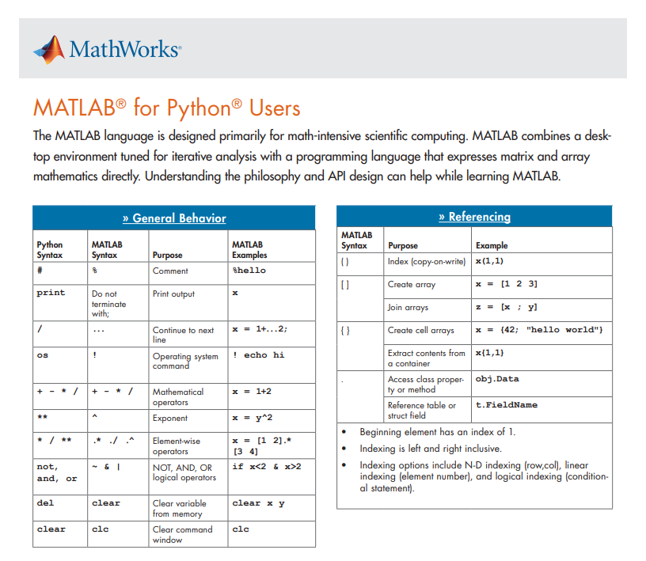
NEW MATLAB for Python Users Cheat Sheet

Slide 25
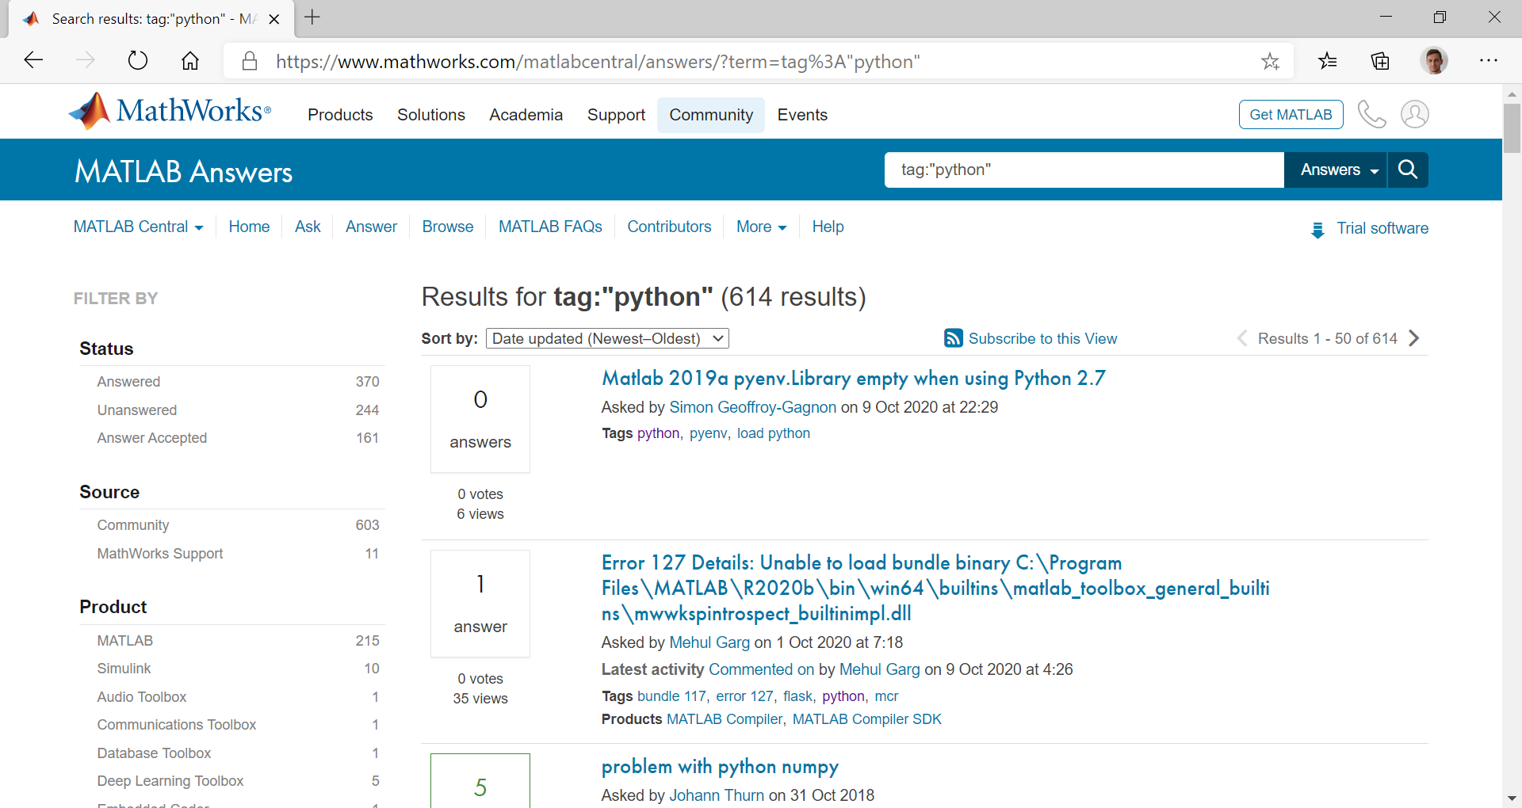
MATLAB Answers – tag:"python"
https://www.mathworks.com/matlabcentral/answers/?term=tag%3A%22python%22

Slide 26
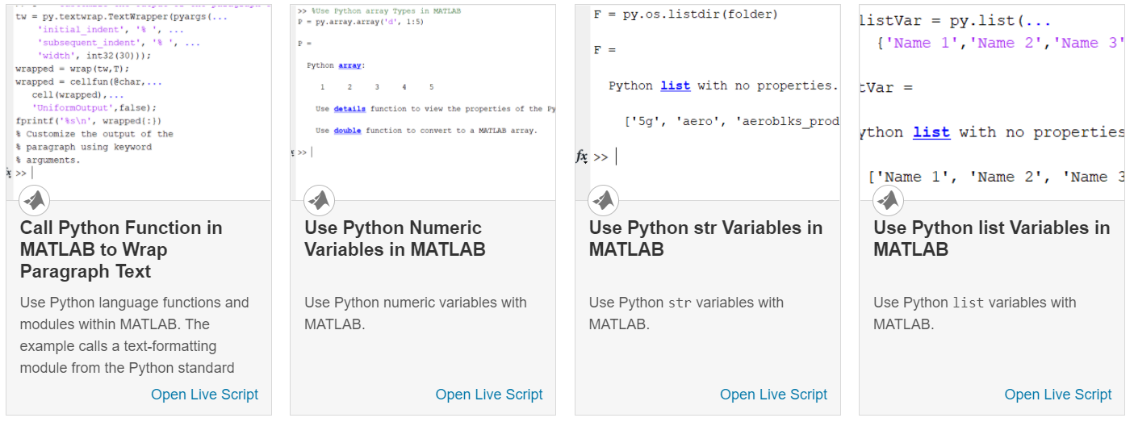
Python libraries in MATLAB (1) Directly call Python® functionality from MATLAB®
Using Python Libraries
Access Python Modules from MATLAB - Getting Started
How to create and use a Python object in MATLAB.
Configure Your System to Use Python
How to verify you have installed a supported version of Python.
Call User-Defined Python Module
Create a Python module used by examples in this documentation.
Understand Python Function Arguments
Python method syntax which might be unfamiliar to MATLAB users.
Advanced Topics
Code pattern differences you should be aware of.
Out-of-Process Execution of Python Functionality
Execute Python scripts in processes that are separate from the MATLAB process.
Reload Out-of-Process Python Interpreter
Reload out-of-process Python interpreter without restarting MATLAB.
https://www.mathworks.com/help/matlab/call-python-libraries.html

Slide 27
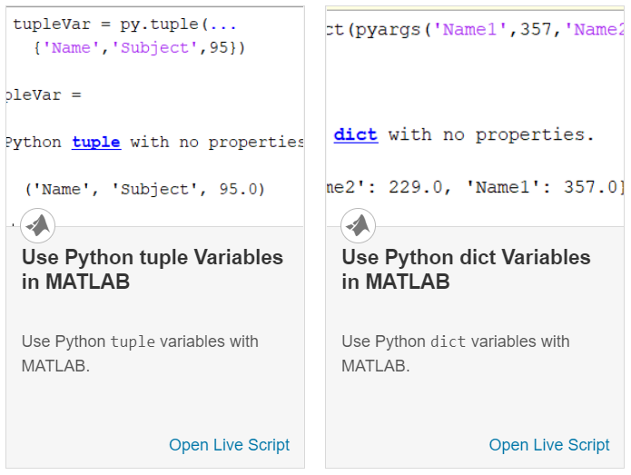
Python libraries in MATLAB (2) Directly call Python® functionality from MATLAB®
Passing Data
MATLAB to Python Data Type Mapping
How MATLAB converts MATLAB data into compatible Python data types.
Access Elements in Python Container Types
A Python container is typically a sequence type (list or tuple) or a mapping type (dict).
Pass Python Function to Python map Function
This example shows how to display the length of each word in a list.

Slide 28
Additional resources

Slide 29
Resources
General:
https://www.mathworks.com/products/matlab/matlab-and-python.html
Python from MATLAB:
https://www.mathworks.com/help/matlab/call-python-libraries.html
MATLAB from Python:
MATLAB Engine API:
https://www.mathworks.com/help/matlab/matlab-engine-for-python.html
MATLAB Compiler SDK:
https://www.mathworks.com/help/compiler_sdk/python_packages.html
Data type conversions:
https://www.mathworks.com/help/matlab/python-data-types.html
Example:
https://github.com/mathworks/matlab-with-python

